Slide 1
CSR Activities
Charitable organisations associated:
Lord Venkateshwara Charitable Trust
Smt. Uttara Devi Charitable & Research Foundations
Programs undertaken by Venky’s :
Education and Employment
Eradicating Hunger, Poverty and Encouraging Sports
Promotion of Healthcare

Slide 2
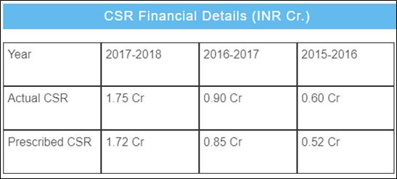
CSR Activities

Slide 3
Funding
Sources of Funds
Particular | Amount (in RS crore)
Share Capital | 14.09
Reserves | 867.40
Total Shareholders’ Funds | 881.49
Secured loans | 203.33
Unsecured loans | 77.28
Total Debt | 280.61
Total Liabilities | 1162.10

Slide 4
Funding
Shareholders’ Pattern
Category | No. of Shares | %
Promoters | 78,01,558 | 55.38
Mutual Funds/Unit Trust of India | 878 | 0.01
Financial Institutions/ Banks | 25,503 | 0.18
Foreign Institution Investors | 1,02,885 | 0.73
Private Bodies Corporate | 9,85,347 | 7.00
Non-Resident Indians | 75,124 | 0.53
Public | 50,96,041 | 36.17
Total | 1,40,87,336 | 100

Slide 5
Revenue Trends
Increasing Incomes Coupled by Changing Food Habits
Growth in the Food Services Market
Growth in the Bakery Foods Market

Slide 6
Revenue Trends

Slide 7
Operating Profit Trends

Slide 8
Operating Profit Trends
Reason for declining profit in 2018-19:
Increase in input costs of poultry feed ingredients
Expansion projects of solvent extraction plant and vegetable oil refinery in Maharashtra
Expansion of Specific Pathogen Free Eggs capacity by setting up a new production unit.

